Slide 1






Enhanced environmental protection inspection for efficient control of air quality monitoring and of all entities under obligation within system of greenhouse gas emission allowance trading, in order to achieve better quality of air in Republic of Croatia
This project is funded by the European Union

Slide 2



Theme 4: Networks
Energy Research and Environmental Protection Institute
Mato Papić dipl. ing. stroj.
Bojan Abramović dipl. ing. stroj.

Slide 3

4.1 WHAT ARE THE AIR QUALITY MONITORING NETWORKS?
Air quality monitoring is carried out by organizing a network of units-stations and their allocation to a particular area.
Air quality monitoring networks are the basic unit of each air quality monitoring.
Energy Research and Environmental Protection Institute

Slide 4
4.1 WHAT ARE THE AIR QUALITY MONITORING NETWORKS?
From experience it is known that in a certain area, no matter how big it is, there may be significant differences in concentrations of pollutants in the air.
Also, it is known that at the same site concentration can vary significantly over time.
If we want to fulfil the basic target of air quality monitoring, certainty of determining the spatial and temporal distribution of pollutants in the air in a certain area has to be greater. The best way to do this is by deploying measuring instruments at the characteristic points of that area and measuring during a representative time interval
Energy Research and Environmental Protection Institute

Slide 5
4.2 THE ORGANISATIONAL STRUCTURE
In order to protect the instruments from the weather conditions, and avoid building a large number of small laboratories, instruments will be placed in a shelter that will provide appropriate conditions for the operation of the instruments and will thus create stations for air quality monitoring. Each station will contain the instruments for the measurement of those pollutants which have to be measured.
Energy Research and Environmental Protection Institute

Slide 6
4.2 THE ORGANISATIONAL STRUCTURE
During the measurement the instruments, often located at different locations, generate a lot of measuring data. That's why modern IT technology is used and all the instruments from all the stations are connected to a computer that accepts their measurement results and keeps them in one place in one laboratoty.
All of the above mentioned elements together make the air quality monitoring network
Energy Research and Environmental Protection Institute

Slide 7
4.2 THE ORGANISATIONAL STRUCTURE
So, air quality monitoring networks are the measuring systems which consist of measuring stations connected to the central computer, which, with the help of a software application, communicates with stations, downloads and saves the results.
Example of a network that consists of three stations is shown in Figure 1, and the example of data flow from the station to the user in Figure 2.
Energy Research and Environmental Protection Institute

Slide 8
4.2 THE ORGANISATIONAL STRUCTURE
Figure 1. Air quality monitoring network
Energy Research and Environmental Protection Institute

Slide 9
4.2 THE ORGANISATIONAL STRUCTURE
Figure 2. Example of data flow from the station to the user
Energy Research and Environmental Protection Institute

Slide 10
4.3 AIR QUALITY MONITORING STATE NETWORK
For the purpose of air quality monitoring in zones (table 1) and agglomerations (table 2 and fig. 3) air quality monitoring network has been established in Republic Croatia (the state network).
The state network is an integral part of the environment monitoring and is financed from the state budget.
Air quality data from the state network are public, they are published on the Environmental Agency's website and are used for the purposes of the air quality reports and data exchange with the EU. These data are an integral part of the ait protection information system.
Energy Research and Environmental Protection Institute

Slide 11
4.3 AIR QUALITY MONITORING STATE NETWORK
Table 1. The classification of the zones in the Republic of Croatia
Energy Research and Environmental Protection Institute

Slide 12
4.3 AIR QUALITY MONITORING STATE NETWORK
Table 2. Classification of agglomeration in the Republic of Croatia
Energy Research and Environmental Protection Institute

Slide 13
4.3 AIR QUALITY MONITORING STATE NETWORK
Figure 3. Zones and agglomerations for the monitoring and evaluation of air quality in the Republic of Croatia
Energy Research and Environmental Protection Institute

Slide 14
4.3 AIR QUALITY MONITORING STATE NETWORK
The public network is designed to provide information on levels of air pollution in all zones and agglomerations.
The Regulation on the establishment of a list of measuring points for the monitoring of concentrations of certain pollutants in the air and the location of measurement stations in the national network for the continuous monitoring of air quality (Official Gazette 65/16) establishes a list of measuring locations for the monitoring of pollutants concentration in the air: sulphur dioxide, nitrogen dioxides and nitrogen oxides, PM10 and PM2,5, lead, benzene, carbon monoxide, ground-level ozone and precursors of ground-level ozone, arsenic, cadmium, mercury, nickel, benzo (a) pyrene and other polycyclic aromatic hydrocarbons in air.
This regulation also establishes the location of measuring stations in the state network for permanent monitoring of air quality in zones and agglomerations, Table 3. and Figure 4.
Energy Research and Environmental Protection Institute

Slide 15
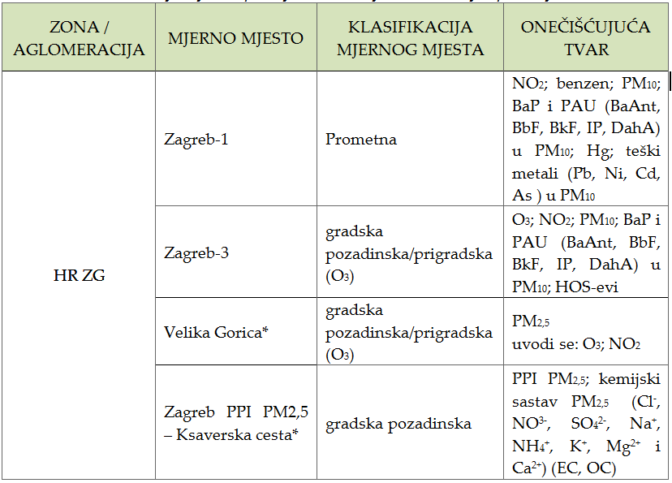
4.3 AIR QUALITY MONITORING STATE NETWORK
Table 3. The location of measuring stations in the air quality monitoring state network
Energy Research and Environmental Protection Institute

Slide 16
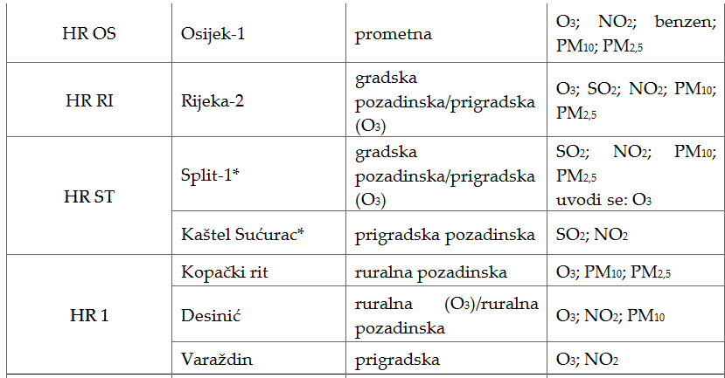
4.3 AIR QUALITY MONITORING STATE NETWORK
Table 3. The location of measuring stations in the air quality monitoring state network (continuation)
Energy Research and Environmental Protection Institute

Slide 17
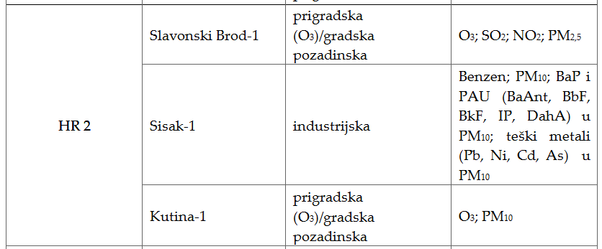
4.3 AIR QUALITY MONITORING STATE NETWORK
Table 3. The location of measuring stations in the air quality monitoring state network (continuation)
Energy Research and Environmental Protection Institute

Slide 18
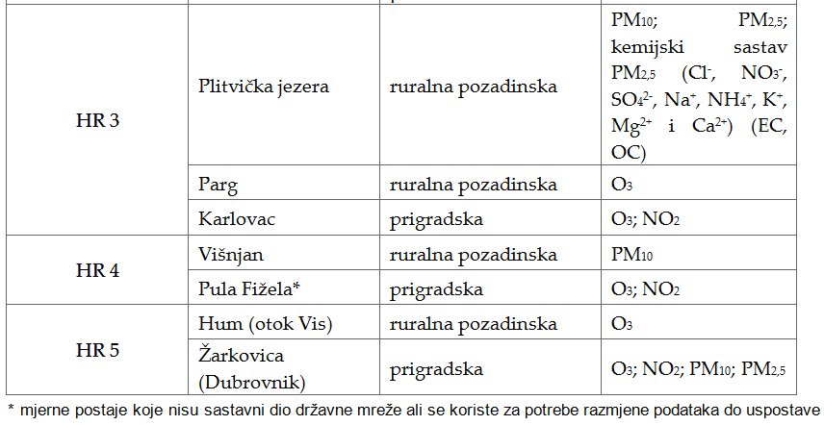
4.3 AIR QUALITY MONITORING STATE NETWORK
Table 3. The location of measuring stations in the air quality monitoring state network (continuation)
Energy Research and Environmental Protection Institute

Slide 19
4.3 AIR QUALITY MONITORING STATE NETWORK
Fig. 4. Sate network for air quality monitoring without the stations from local networks that are currently being used.
Energy Research and Environmental Protection Institute

Slide 20
4.3 AIR QUALITY MONITORING STATE NETWORK
The Air Quality Monitoring Program in the state network (Official Gazette 73/16) defines all measurements in the national network. Most measurements are already being carried out and measurements for individual pollutants will be introduced later.
The program include:
Program A air quality monitoring in the stations established in the aglomerations and
Program B air quality monitoring in the stations established in the zones.
Energy Research and Environmental Protection Institute

Slide 21
4.3 AIR QUALITY MONITORING STATE NETWORK
The Program provides detailed measurement program for each station in the state network and pollutant list, with a measurement method for each of them. Also, locations and a measurement program for new monitoring stations in the state network that have to be built are also given.
Energy Research and Environmental Protection Institute

Slide 22
4.4 LOCAL NETWORK FOR AIR QUALITY MONITORING
Articles 31., 32. and 33. of ZOZZ give the legal framework for monitoring the air quality outside of the state network at the local level.
There are three basic reasons and ways to run measurements outside the state network:
1. County, the City of Zagreb and the cities establish air quality monitoring stations in their area, if they estimate that levels of contamination are more than the prescribed limit values (GV), i.e. if they estimate there are reasonable grounds for that (in particular in the case of increased industrial development, business and industrial zone expansion and so on). Representative body of these units determines the location of air quality monitoring stations, defines the Program for measuring pollution levels and ensures the conditions for its implementation.
Energy Research and Environmental Protection Institute

Slide 23
4.4 LOCAL NETWORK FOR AIR QUALITY MONITORING
2. The polluter has to ensure air quality monitoring according to the environmental acceptability decision or the permit to the integrated environmental protection requirements or environmental permit in accordance with the Environmental Protection Law.
3. In cases where there is a suspicion, expressed by citizens' complaint, that there has been an air pollution whose quality is likely to impair human health, quality of life and / or adversely affect any environmental component, special purpose measurements or assessment of the level of contamination must be carried out. The executive body of the City of Zagreb, the city and the municipality, at the request of the environmental inspection to determine the justification of the above suspicions, is obliged to make a decision on special purposes measuring or estimating the level of contamination within eight days. If the measurement or estimation determines that no excessive contamination has occurred or excessive contamination has occurred and the polluter is not known, the costs should be paid by the units of local self-government whose decision has been taken by the executing authority.
Energy Research and Environmental Protection Institute

Slide 24
4.4 LOCAL NETWORK FOR AIR QUALITY MONITORING
If excessive air pollution is determined by measurement or estimation, and the polluter is known, the cost of measurement or estimation should be paid by the polluter. If the executive body of the City of Zagreb, the city and the municipalities does not make a decision, the Ministry shall provide measurements of special purpose or assessment of the pollution level at the expense and responsibility of the local self-government unit whose executive body has not made a decision.
Energy Research and Environmental Protection Institute

Slide 25
4.4 LOCAL NETWORK FOR AIR QUALITY MONITORING
All the measurements which are performed from the reasons mentioned above must be carried out in accordance with the regulations on the air quality monitoring by the testing laboratory with permission from the Ministry for air quality monitoring for those pollutants that will be measured on a local area network. The engagement testing laboratories shall submit original and validated air quality monitoring data and report on pollution levels and air quality assessment to the competent county administrative authority of the County, City of Zagreb and the city by March 31 of the current year for the previous calendar year and the competent authority shall submit the same data in the Agency until April 30 of the same year.
Energy Research and Environmental Protection Institute

Slide 26
4.4 LOCAL NETWORK FOR AIR QUALITY MONITORING
Only automatic stations that use the reference methods are shown for all zones and agglomerations except for the agglomeration HR-ZG which includes the stations with sampling methods also (manual methods).
Energy Research and Environmental Protection Institute

Slide 27
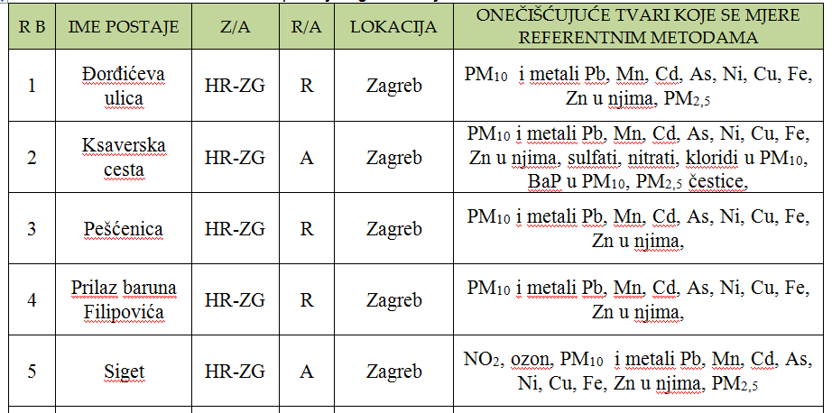
4.4 LOCAL NETWORK FOR AIR QUALITY MONITORING
Table 4. Local networks and HR-ZG agglomeration stations
Energy Research and Environmental Protection Institute

Slide 28
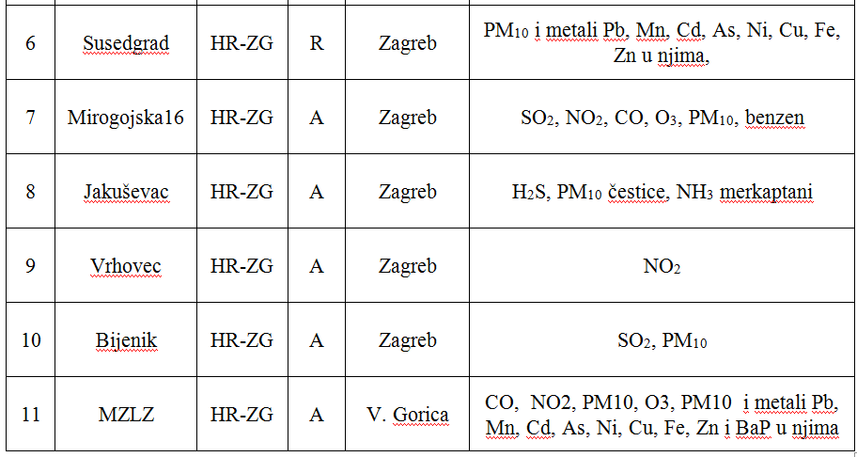
4.4 LOCAL NETWORK FOR AIR QUALITY MONITORING
Table 4. Local networks and HR-ZG agglomeration stations (continuation)
Energy Research and Environmental Protection Institute

Slide 29
4.4 LOCAL NETWORK FOR AIR QUALITY MONITORING
Figure 5. The position of local networks and HR-ZG
agglomeration stations
Energy Research and Environmental Protection Institute

Slide 30
4.4 LOCAL NETWORK FOR AIR QUALITY MONITORING
Table 5. Local networks and stations in the Sisak-Moslavina county
Energy Research and Environmental Protection Institute

Slide 31
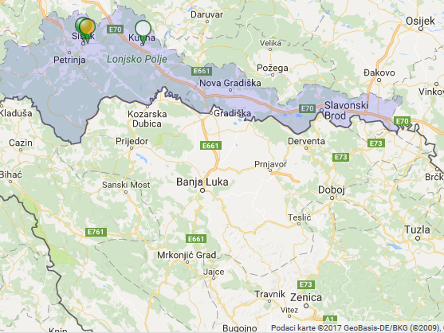
4.4 LOCAL NETWORK FOR AIR QUALITY MONITORING
Figure 6. The position of local networks and stations in Sisak-Moslavina county
Energy Research and Environmental Protection Institute

Slide 32
4.4 LOCAL NETWORK FOR AIR QUALITY MONITORING
Table 6. Local networks and stations in Istrian County
Energy Research and Environmental Protection Institute

Slide 33
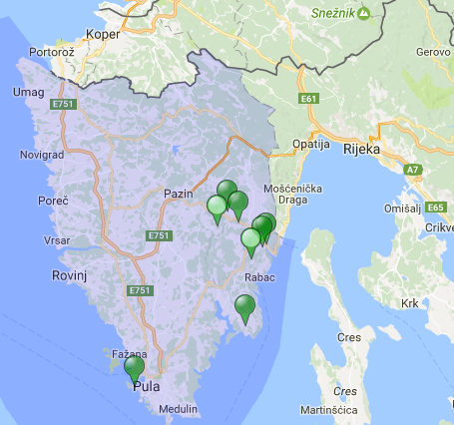
4.4 LOCAL NETWORK FOR AIR QUALITY MONITORING
Figure 7. The position of local networks and stations of the Istrian County
Energy Research and Environmental Protection Institute

Slide 34
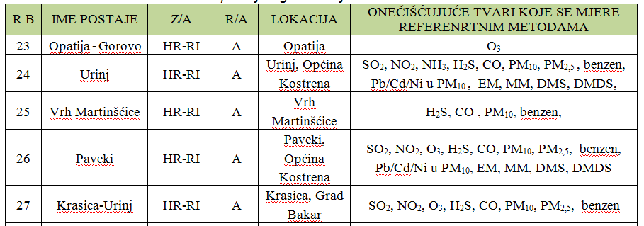
4.4 LOCAL NETWORK FOR AIR QUALITY MONITORING
Table 7. Local networks and stations in HR-RI agglomeration
Energy Research and Environmental Protection Institute

Slide 35
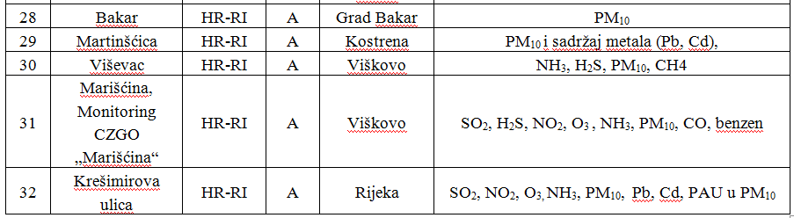
4.4 LOCAL NETWORK FOR AIR QUALITY MONITORING
Table 7. Local networks and stations in HR-RI agglomeration (continuation)
Energy Research and Environmental Protection Institute

Slide 36
4.4 LOCAL NETWORK FOR AIR QUALITY MONITORING
Figure 8. The position of local networks and stations in HR-RI agglomeration
Energy Research and Environmental Protection Institute

Slide 37
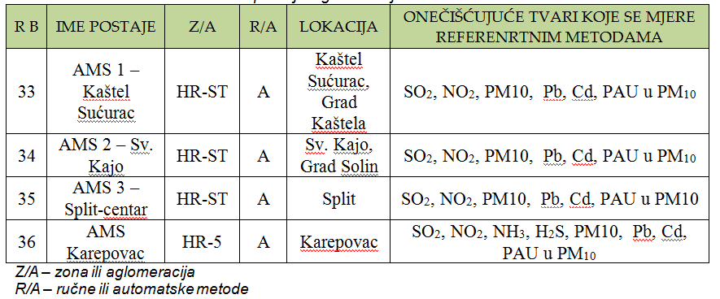
4.4 LOCAL NETWORK FOR AIR QUALITY MONITORING
Table 8. Local networks and stations in HR-ST agglomeration
Energy Research and Environmental Protection Institute

Slide 38
4.4 LOCAL NETWORK FOR AIR QUALITY MONITORING
Figure 9. The position of local networks and stations in HR-ST agglomeration
Energy Research and Environmental Protection Institute

Slide 39
4.5 measurements of special purpose (INDUSTRIAL NETWORKS)
Measures of special purpose must be carried out or it is necessary to estimate the level of pollution in cases where there is a suspicion expressed by citizens' complaint that air is contaminated so much that it can disturb human health, quality of life and / or have adverse effects on any environmental component. The executive body of the City of Zagreb, the city and the municipality, at the request of the environmental inspection to determine the justification of the above suspicion, is obliged to make a decision on the measurement of the special purpose or the assessment of the level of pollution within eight days.
Energy Research and Environmental Protection Institute

Slide 40
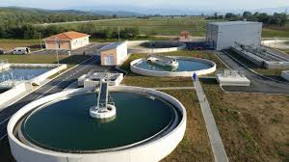
4.5 measurements of special purpose (INDUSTRIAL NETWORKS)
These measurements are carried out after inspection supervision establishes a grounded suspicion of excessive pollution after the alert of the citizen.
The most common examples are the spread of unpleasant smells from a known or unknown source
Energy Research and Environmental Protection Institute

Slide 41
4.5 measurements of special purpose (INDUSTRIAL NETWORKS)
Most often JLS or inspectors require:
hydrogen sulphide
Mercaptans
Ammonia
PM10
The first two can smell at concentrations of just a few ppb and can endanger the quality of life.
Unfortunately they are not the only "smelly" ...
PM10 is a pollutant that currently most endangers human health at the global level.
Energy Research and Environmental Protection Institute

Slide 42
4.5 measurements of special purpose (INDUSTRIAL NETWORKS)
Complaints / complaints from citizens on unpleasant odors are common. If it's just about to, though it does look dramatic, there's no place to panic. All three substances are acutely toxic only at concentrations of 1000x higher than those causing stench.
Then the citizens can no longer smell them.
Eg. (lowest-adverse-effect level - LOAEL) The lowest concentration causing adverse effect for H2S is 15000 μg / m3 when it can cause eyes irritation (GV) and GV is 7 and 5 μg / m3.
Energy Research and Environmental Protection Institute

Slide 43
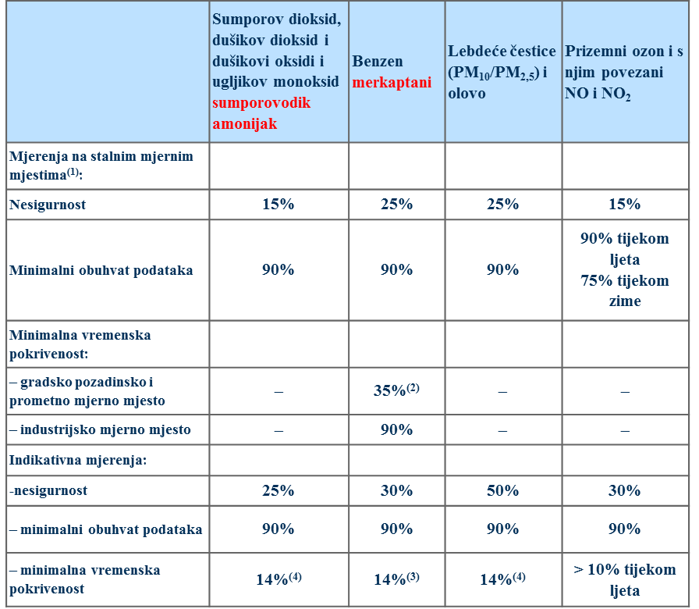
4.5 measurements of special purpose (INDUSTRIAL NETWORKS)
In these measurements, attention should be paid to the quality of data.
Energy Research and Environmental Protection Institute

Slide 44
4.5 measurements of special purpose (INDUSTRIAL NETWORKS)
NOVI PRAVILNIK O PRAĆENJU KVALITETE ZRAKA 7/2017 | Sumporov dioksid, dušikov dioksid i dušikovi oksidi i ugljikov monoksid sumporovodik amonijak | Benzen merkaptani | Lebdeće čestice (PM₁₀/PM_{2,5}) i olovo | Prizemni ozon i s njim povezani NO i NO₂
Mjerenja na stalnim mjernim mjestima⁽¹⁾:
Nesigurnost | 15% | 25% | 25% | 15%
Minimalni obuhvat podataka | 90% | 90% | 90% | 90% tijekom ljeta 75% tijekom zime
Minimalna vremenska pokrivenost:
– gradsko pozadinsko i prometno mjerno mjesto | – | 35%⁽²⁾ | – | –
– industrijsko mjerno mjesto | – | 90% | – | –
Indikativna mjerenja:
-nesigurnost | 25% | 30% | 50% | 30%
– minimalni obuhvat podataka | 90% | 90% | 90% | 90%
– minimalna vremenska pokrivenost | 14%⁽⁴⁾ | 14%⁽³⁾ | 14%⁽⁴⁾ | > 10% tijekom ljeta
⁽⁴⁾ One measurement a week at random uniformly distributed over the year, or eight weeks measurement distributed over the year.
2 weeks of measurements in each season!
Energy Research and Environmental Protection Institute

Slide 45
4.5 measurements of special purpose (INDUSTRIAL NETWORKS)
It is essential to respect these goals because otherwise it is possible to make a completely wrong assessment of air quality.
Study of a sample example
Case study - "MEASUREMENTS of NH3, H2S and MERCAPTANs in the Republic of Croatia legislation and practice"
Energy Research and Environmental Protection Institute

Slide 46
4.5 measurements of special purpose (INDUSTRIAL NETWORKS)
PM10 is often measured. Attention should be paid here to the methods. It is best if the measurements are performed by a reference method (gravimetry).
- beta beam attenuation - lower
- optical methods - more
It is imperative to make a "study of equivalence"
Case study - "THE EFFECT OF APPLICATION OF ECVIVALENCY CORRECTION FUNCTIONS TO exceeding the limit values FOR PM10 IN THE STATE NETWORK FOR AIR QUALITY MONITORING "
Energy Research and Environmental Protection Institute

Slide 47
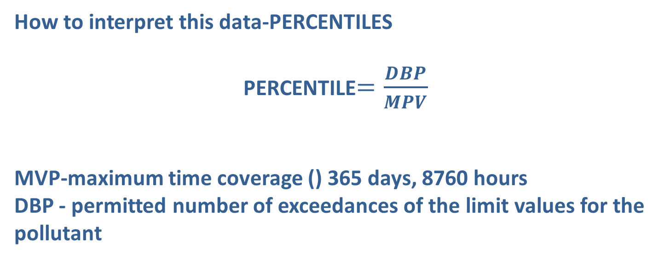
4.5 measurements of special purpose (INDUSTRIAL NETWORKS)
How to interpret this data-PERCENTILES
PERCENTILE$=\frac{DBP}{MPV}$
MVP-maximum time coverage () 365 days, 8760 hours
DBP - permitted number of exceedances of the limit values for the pollutant
Energy Research and Environmental Protection Institute

Slide 48
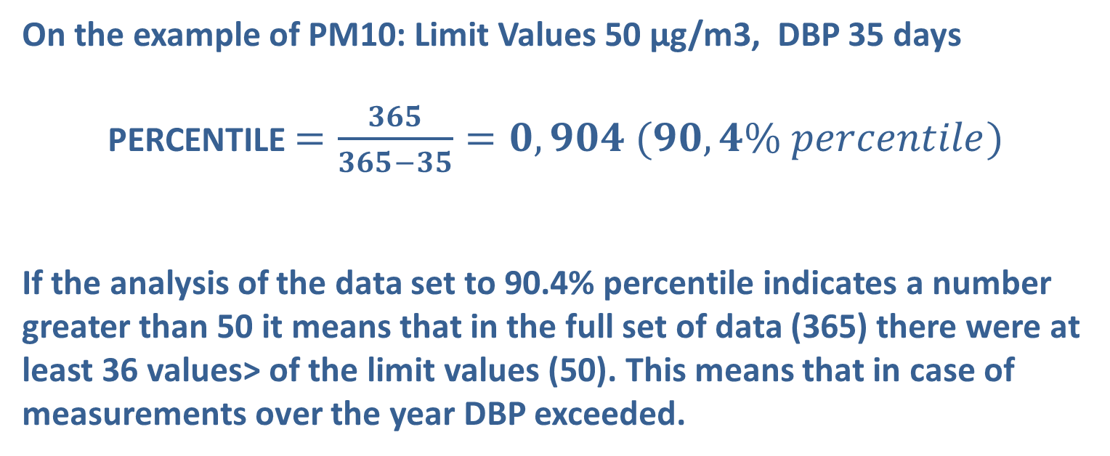
4.5 measurements of special purpose (INDUSTRIAL NETWORKS)
On the example of PM10: Limit Values 50 µg/m3, DBP 35 days
PERCENTILE $=\frac{365}{365−35}=0,904 (90,4\% percentile)$
If the analysis of the data set to 90.4% percentile indicates a number greater than 50 it means that in the full set of data (365) there were at least 36 values> of the limit values (50). This means that in case of measurements over the year DBP exceeded.
Energy Research and Environmental Protection Institute

Slide 49
4.5 measurements of special purpose (INDUSTRIAL NETWORKS)
O. T. | PM10 | SO2 | NO2 | H2S | R-SH | NH3
MVP | 365 | 365 | 8760 | 365 | 365 | 365
MVP - DBP | 330 | 362 | 8742 | 358 | 358 | 358
PERCENTIL | 0,904 | 0,992 | 0,998 | 0,981 | 0,981 | 0,981
Ne smije preći | 50 | 125 | 200 | 5 | 30 | 100
An example for afternoon.
Energy Research and Environmental Protection Institute

Slide 50
4.5 measurements of special purpose (INDUSTRIAL NETWORKS)
It is also necessary to be very careful when assessing sources of pollution especially for PM10 in the continental part of the Croatia.
Is mandatory to make a "study of equivalence„
Case study
"analysis of the IMPACT of the ZAGREB INTERNATIONAL AIRPORT on AIR QUALITY„
„THE ANALYSIS OF THE IMPACT OF WASTE LANDFILL PRUDINEC/JAKUŠEVAC ON AIR QUALITY IN THE VILLAGE OF JAKUŠEVAC"
Energy Research and Environmental Protection Institute

Slide 51
THANK YOU FOR YOUR ATTENTION
Energy Research and Environmental Protection Institute
Disclaimer: The contents of this publication are the sole responsibility of EKONERG – Energy Research and Environmental Protection Institute, Ltd. and can in no way be taken to reflect the views of the European Union
This project is funded by the European Union

